Slide 1
SQL Script and Procedures

Slide 2
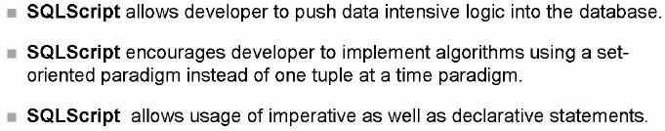
SQL Script
The main motivation for SQLScript is to embed data intensive application logic into the database, in contrast to a traditional approach where the application logic is normally executed in an application server.

Slide 3
Procedures
Procedure is a reusable processing block. The calculation and transformations described in procedures can be parameterized and reused inside other procedures.
Procedure can be implement using SQLScript, L or R language.
Procedures can have multiple input parameters and output parameters (which can be of scalar or table types).
A procedure can be created as read only(without side-effect) or read write.
The body of a procedure consists of a sequence of statements separated by semicolons.
An intermediate variable, inside a procedure, is not required to be defined before it is bound by an assignment.
Variable name is prefixed by':' (colon) while used as input to other statement.
Procedure can be created using SQL editor or using creation wizard.
Read-only procedures can only call other read-only procedures

Slide 4
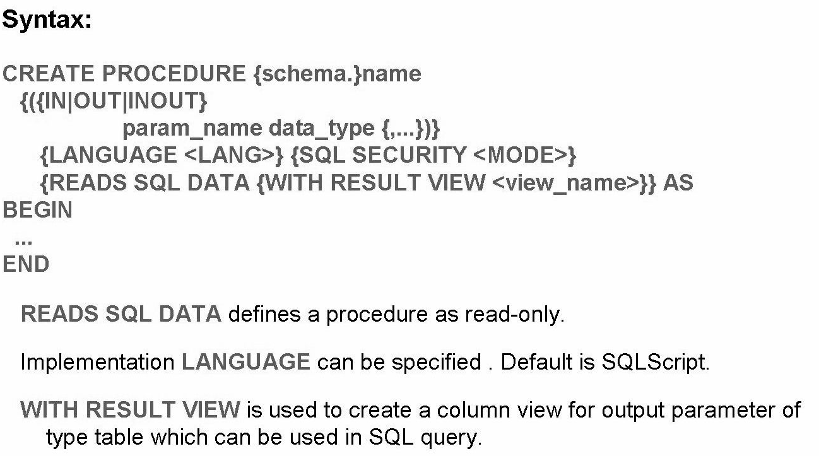
Procedures creation using SQL editor

Slide 5
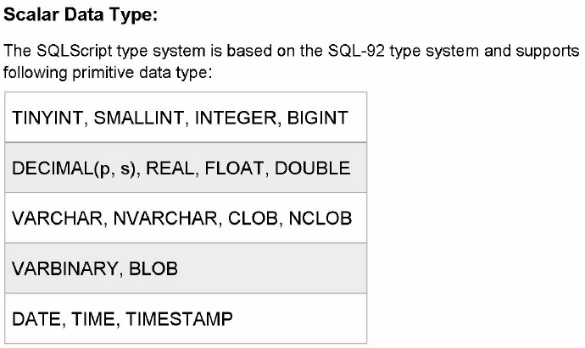
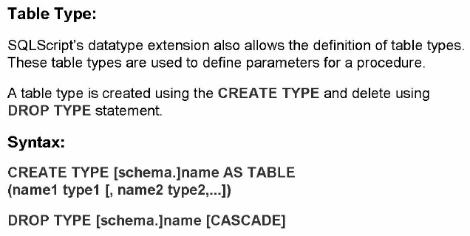

Slide 6
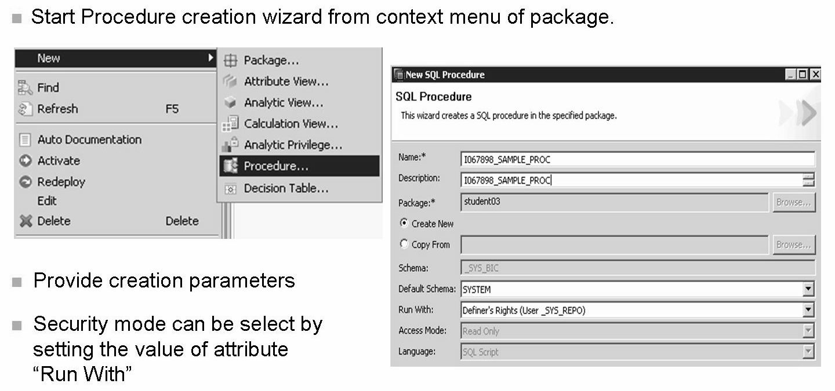
Procedures creation using creation wizard

Slide 7
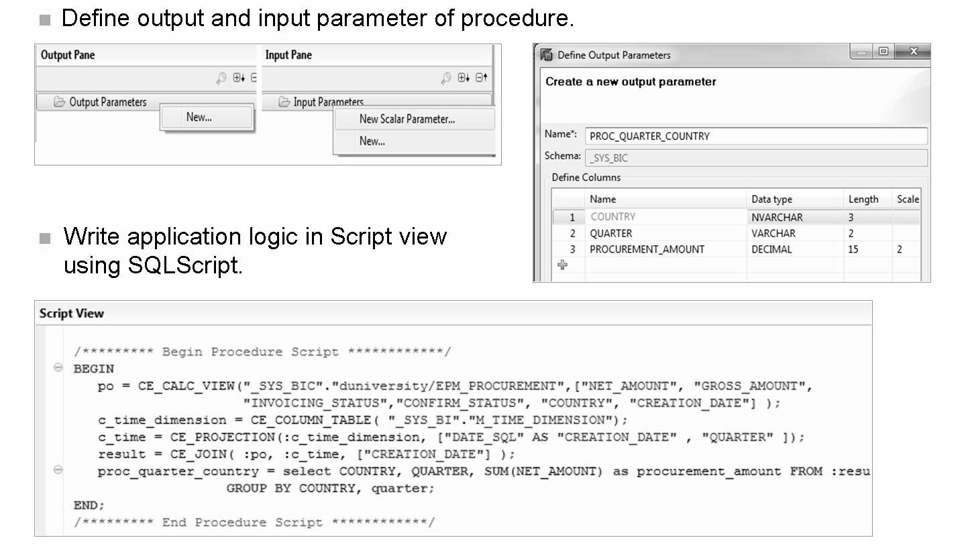

Slide 8
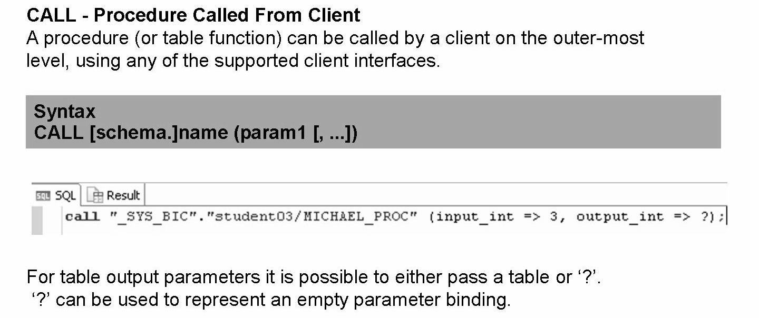
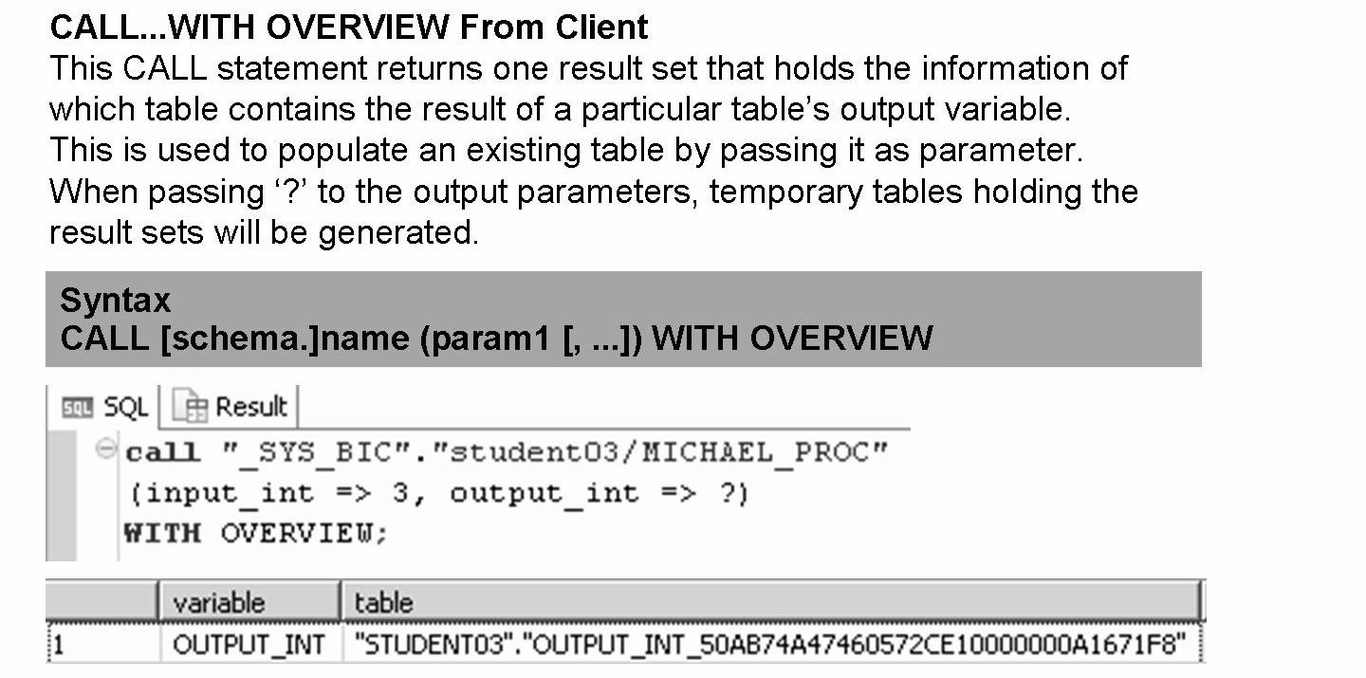

Slide 9
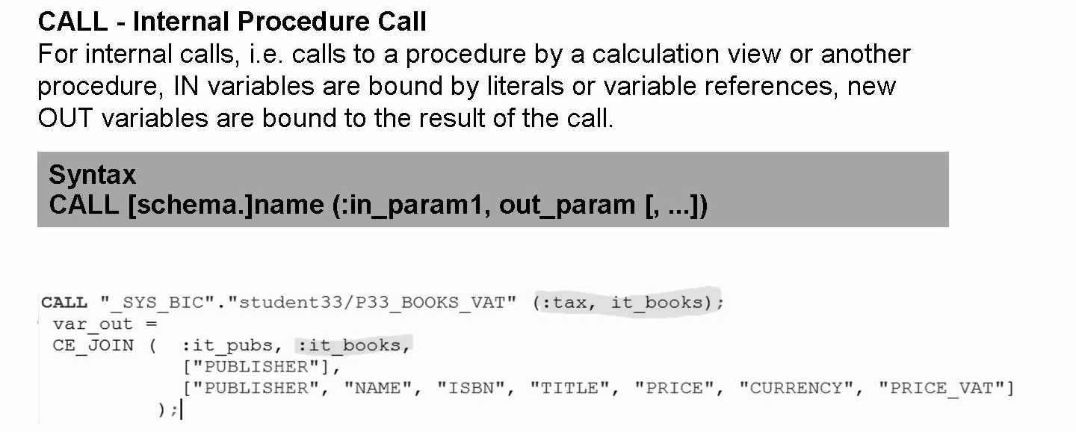

Slide 10
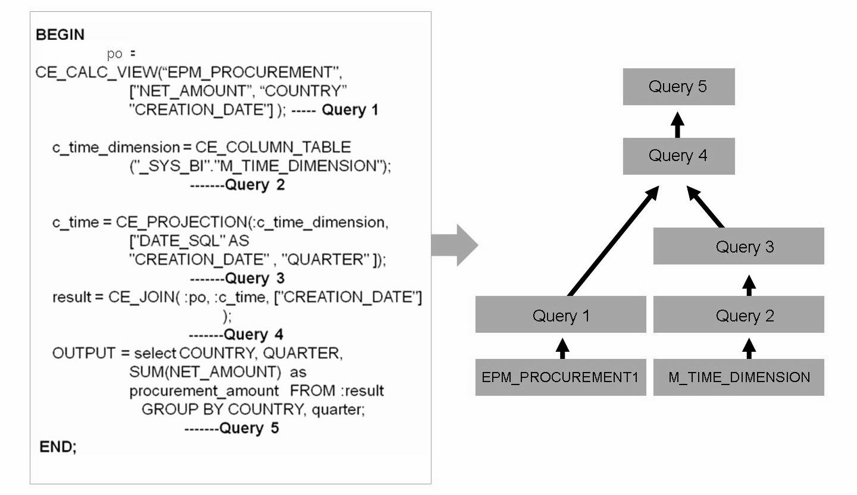

Slide 11
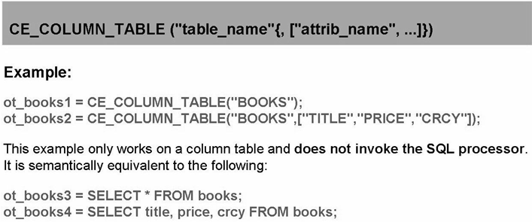
Calculation Engine Plan Operators
It is an alternative to using SQL statements as their logic is directly implemented in the calculation engine.
Data Source Access Functions
CE_COLUMN_TABLE:
It provides access to an existing column table. It takes the name of the table and returns its content bound to a variable. Optionally a list of attribute names can be provided to restrict the output to the given attributes.

Slide 12
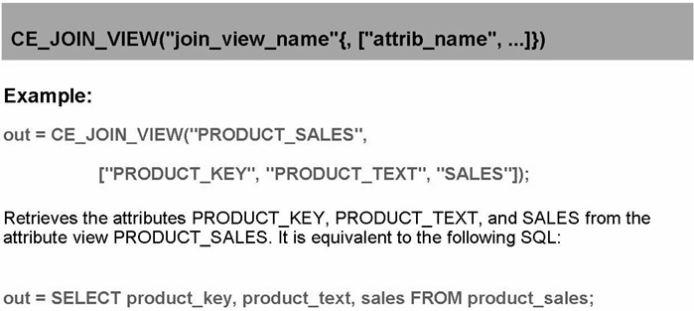
CE_JOIN_VIEW:
The CE_JOIN_VIEW operator returns results for an existing attribute view. It takes the name of the attribute view and an optional list of attributes as parameters of such views/models.

Slide 13
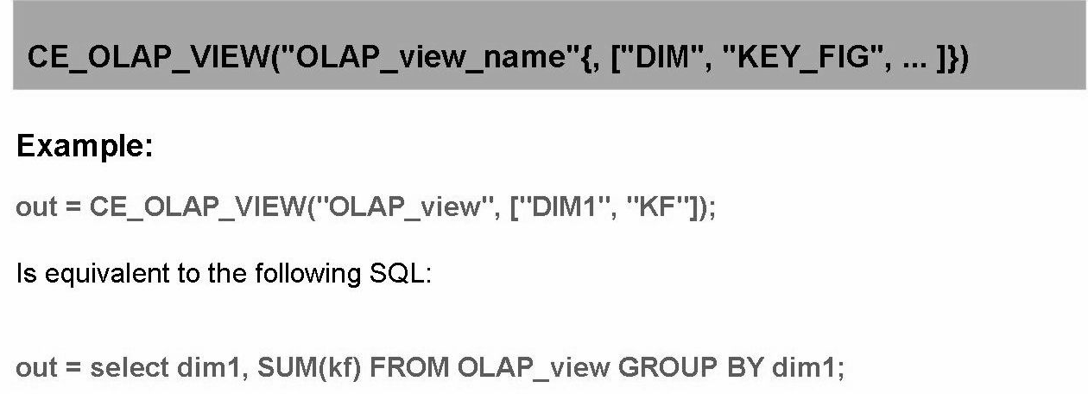
CE_OLAP_VIEW:
The CE_OLAP_VIEW operator returns results for an existing analytic view. It takes the name of the analytic view and an optional list of key figures and dimensions as parameters. The analytic view is grouped by the given dimensions and the key figures are aggregated using the default aggregation of the analytic view.

Slide 14
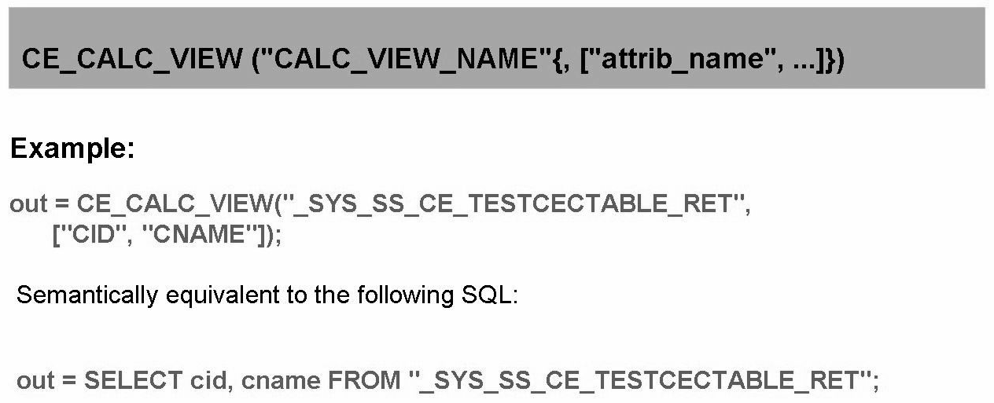
CE_CALC_VIEW:
The CE_CALC_ VIEW operator returns results for an existing calculation view. It takes the name of the calculation view and optionally a projection list of attribute names to restrict the output to the given attributes.

Slide 15
Relational Functions
CE_JOIN:
The CE_JOIN operator calculates a natural (inner) join of the given pair of tables on a list of join attributes.
The plan operator requires each pair of join attributes to have identical attribute names. In case of join attributes having different names, one of them must be renamed prior to the join using a projection.
• Syntactically, the plan operator CE_JOIN takes four parameters as input
• One table variable representing the left argument to be joined.
• One table variable representing the right argument to be joined.
• A list of join attributes. The list must at least have one element.
• For each pair of join attributes, only one attribute will be in the result. Optionally, a projection list can be provided specifying the attributes that should be in the resulting table. If this list is present, it must at least contain the join attributes.

Slide 16
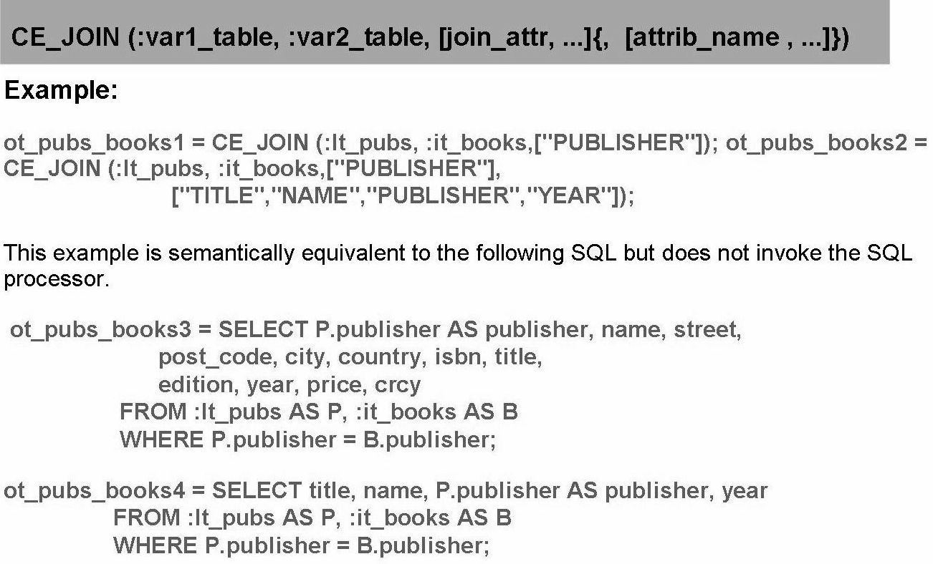
CE_LEFT_OUTER_JOIN
• Calculate the left outer join. Besides the function name, the syntax is the same as for CE_JOIN.
CE_RIGHT_OUTER_JOIN
• Calculate the right outer join. Besides the function name, the syntax is the same as for CE_JOIN.
NOTE: CE_FULL_OUTER_JOIN is not supported.

Slide 17
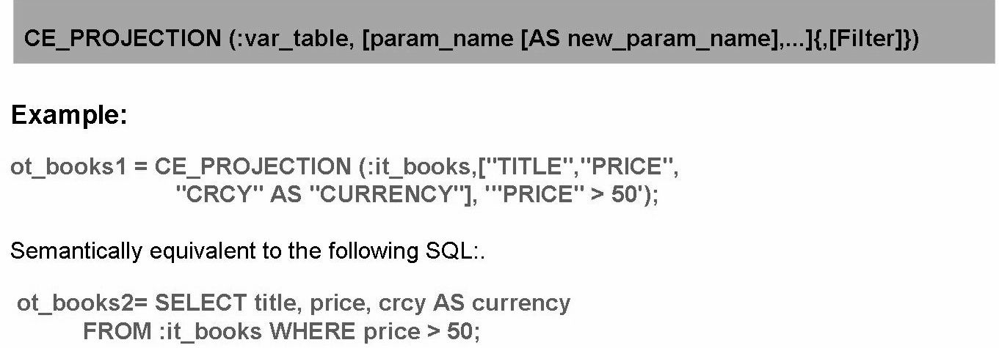
CE_PROJECTION
Restricts the columns in the schema of table variable var_table to those mentioned in the projection list. Optionally renames columns, computes expressions, or applies a filter.
It takes three parameters as input:
• A variable of type table which is subject to the projection. Like CE_JOIN,
CE_PROJECTION cannot handle tables directly as input.
• A list of attributes which should be in the resulting table. The list must at least
have one element. The attributes can be renamed using the SQL keyword AS,
and expressions can be evaluated using the CE_ CALC function.
• An optional filter where Boolean expressions are allowed, as defined for the
CE_ CALC operator below.
In this operator, the projection in parameter 2 is applied first - including column
renaming and computation of expressions. As last step, the filter is applied.

Slide 18
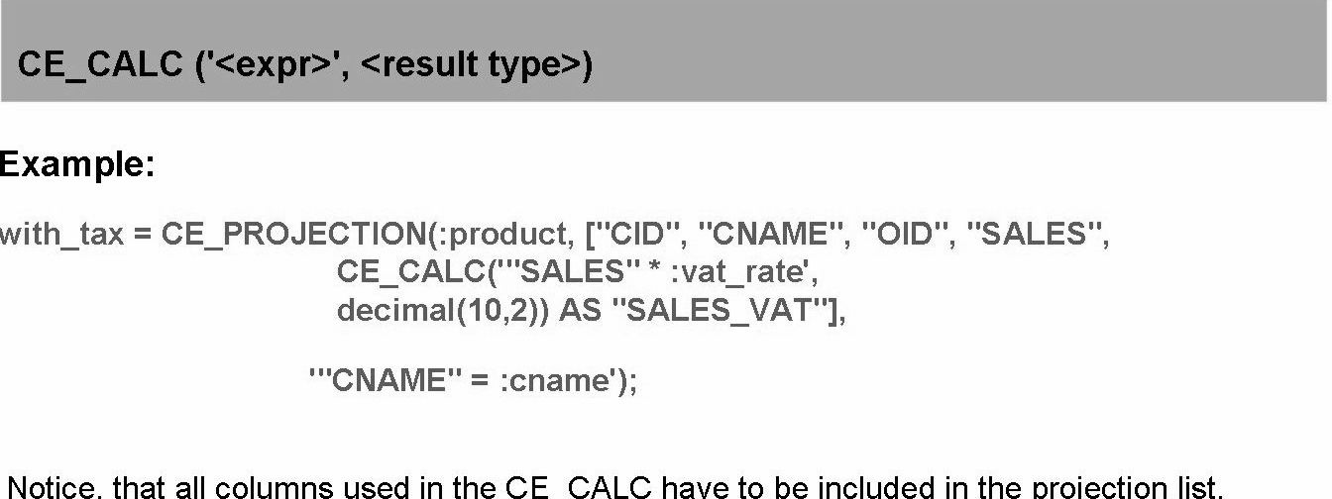
CE_ CALC:
CE_ CALC is used inside other operators discussed in this section. It evaluates an expression and is usually then bound to a new column. An important use case is evaluating expressions in the CE_PROJECTTON. It takes two arguments:
• The expression enclosed in single quotes.
• The result type of the expression as a SQL type.
Another frequent use case of CE_ CALC is computing row numbers:
CREATE PROCEDURE ceGetRowNum(IN it_books books, OUT ranked- books ot-ranked- books)
LANGUAGE SQLSCRIPT READS SQL DATA AS
BEGIN
ordered_books = SELECT title, price, crcy FROM :it_books ORDER BY price DESC;
ranked books - CE_PROJECTION ( :it_books, [ "TITLE", "PRICE", CE_ CALC ( ' rownum() ' , integer) AS "RANK", "CRCY" AS "CURRENCY"]);
END ;

Slide 19
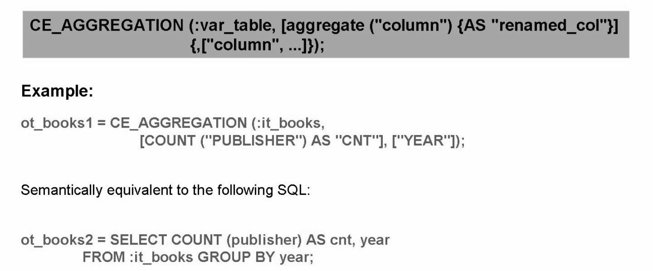
CE_AGGREGATION:
Groups the input and computes aggregates for each group. It takes three input parameters:
• A variable of type table containing the data that should be aggregated. CE_AGGREGATION cannot handle tables directly as input.
• A list of aggregates.
• An optional list of group-by attributes. If this list is absent the entire input table should be treated as a single group, and the aggregate function is applied to all tuples.
• Note that CE_ AGGREGATION implicitly defines a projection: All columns that are not in the list of aggregates, or in the group-by list, are not part of the result.
Supported aggregation functions are:
count(" column"), sum("column“), min("column"), max(" column")
• use sum("column")/count("column") to compute the average

Slide 20
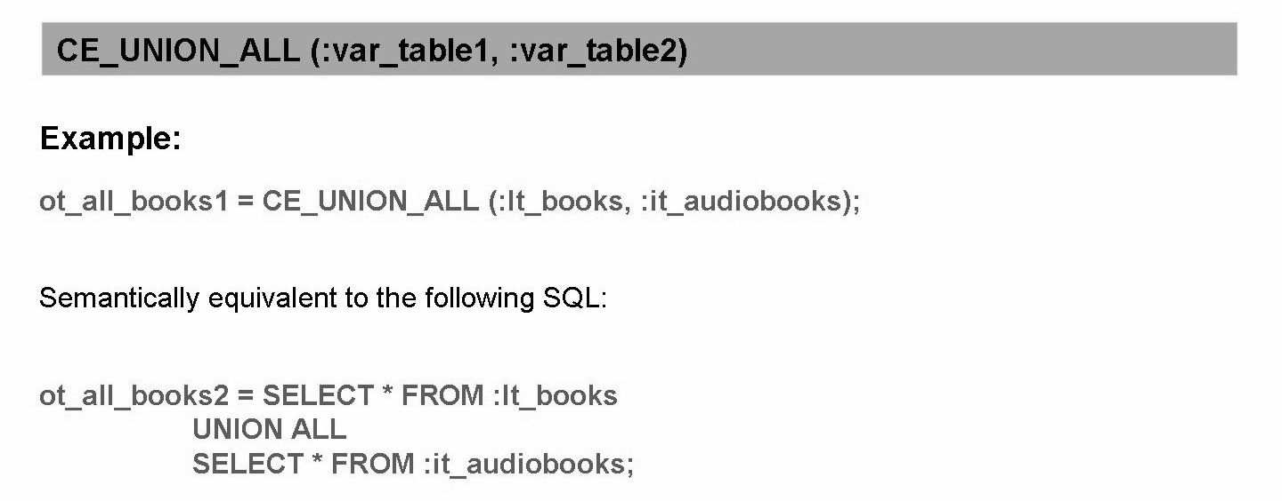
CE_UNION_ALL:
The CE_UNION_ALL function is semantically equivalent to SQL UNION ALL
statement. It computes the union of two tables which need to have identical schemas.
The CE_ UNION_ ALL function preserves duplicates, i.e. the result is a table which
contains all the rows from both input tables.

Slide 21
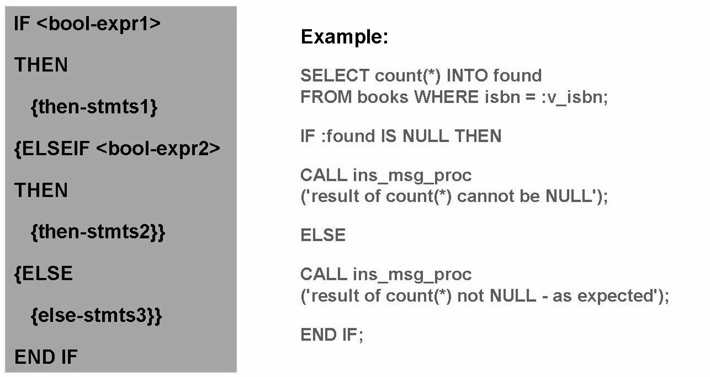
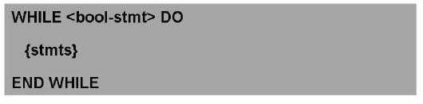
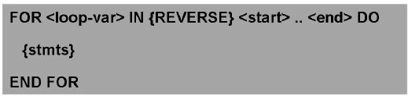
Control statements

Slide 22
EXEC:
The EXEC statement executes the SQL statement passed in a string argument. This statement allows for constructing an SQL statement at execution time of a procedure. Thus, on the one hand dynamic SQL allows to use variables where they might not be supported in SQLScript or more flexibility in creating SQL statements. On the other hand, dynamic SQL comes with an additional cost at runtime:
• Opportunities for optimizations are limited .
• The statement is potentially recompiled every time the statement is executed .
• Not possible to bind the result of a dynamic SQL statement to a SQLScript variable.
• Need be very careful to avoid SQL injection bugs that might harm the integrity or security of the database.
Note: It is recommended to avoid dynamic SQL because it might have a negative impact on security or performance.

Slide 23
THANK YOU
Courtesy : SAP Labs Document -
HA 300 – SAP HANA Implementation and Modeling

